Slide 1
Get the Record
Articles

Slide 2
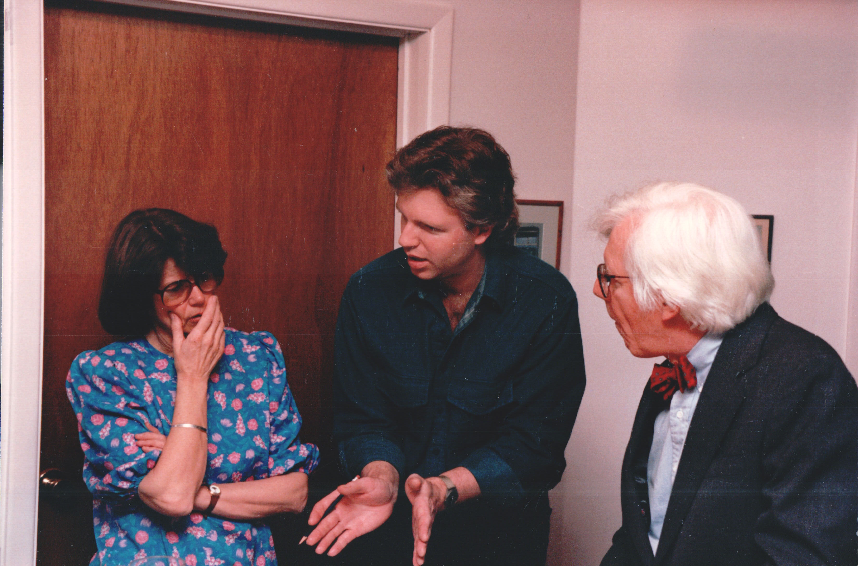
No, no, I think it happened like this-

Slide 3
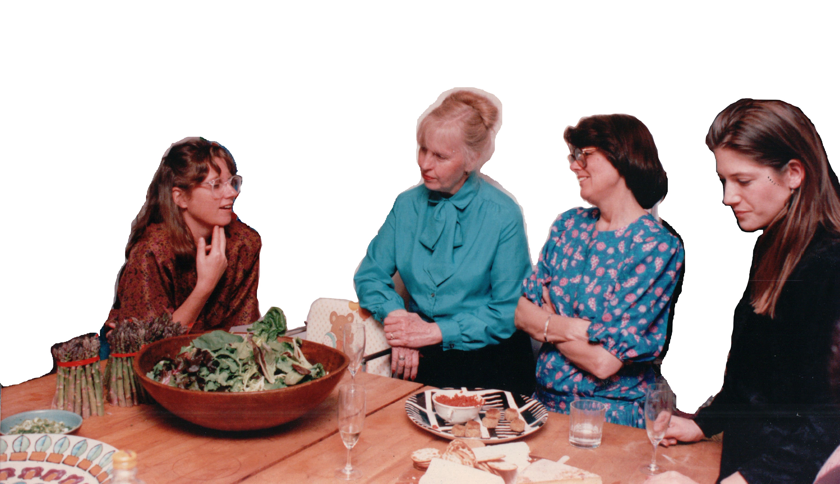
No, no, I think it happened like this-

Slide 4
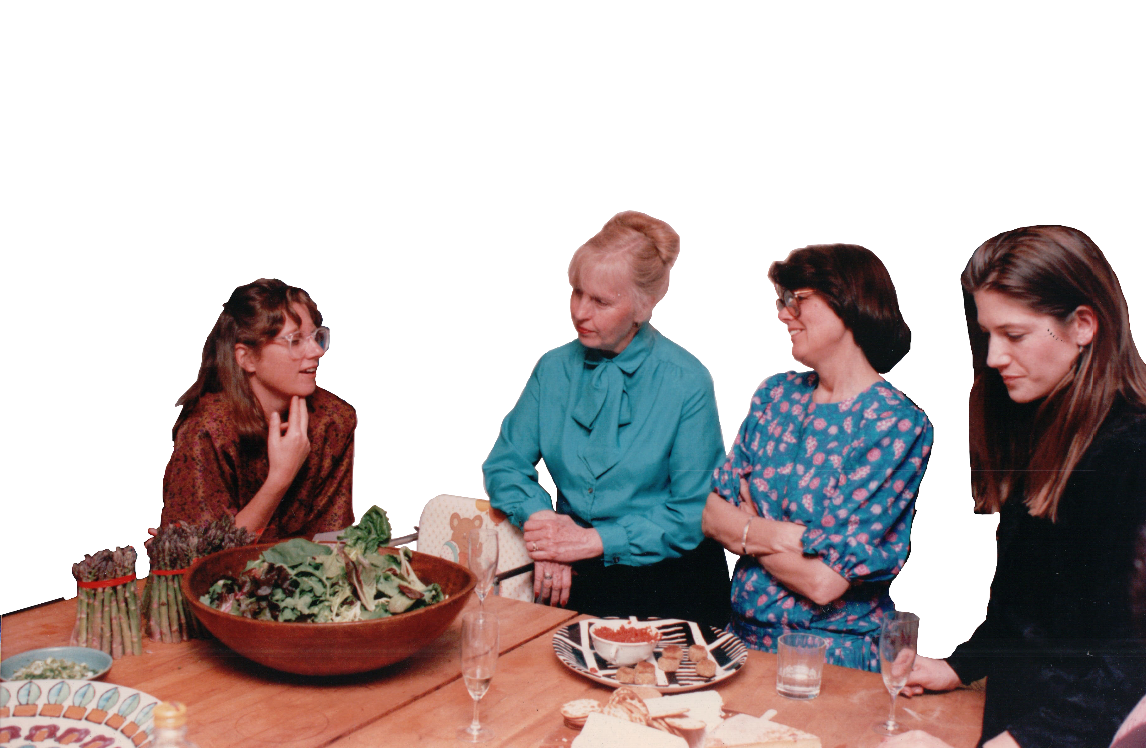
No, no, I think it happened like this-

